Slide 1
React Js

Slide 2
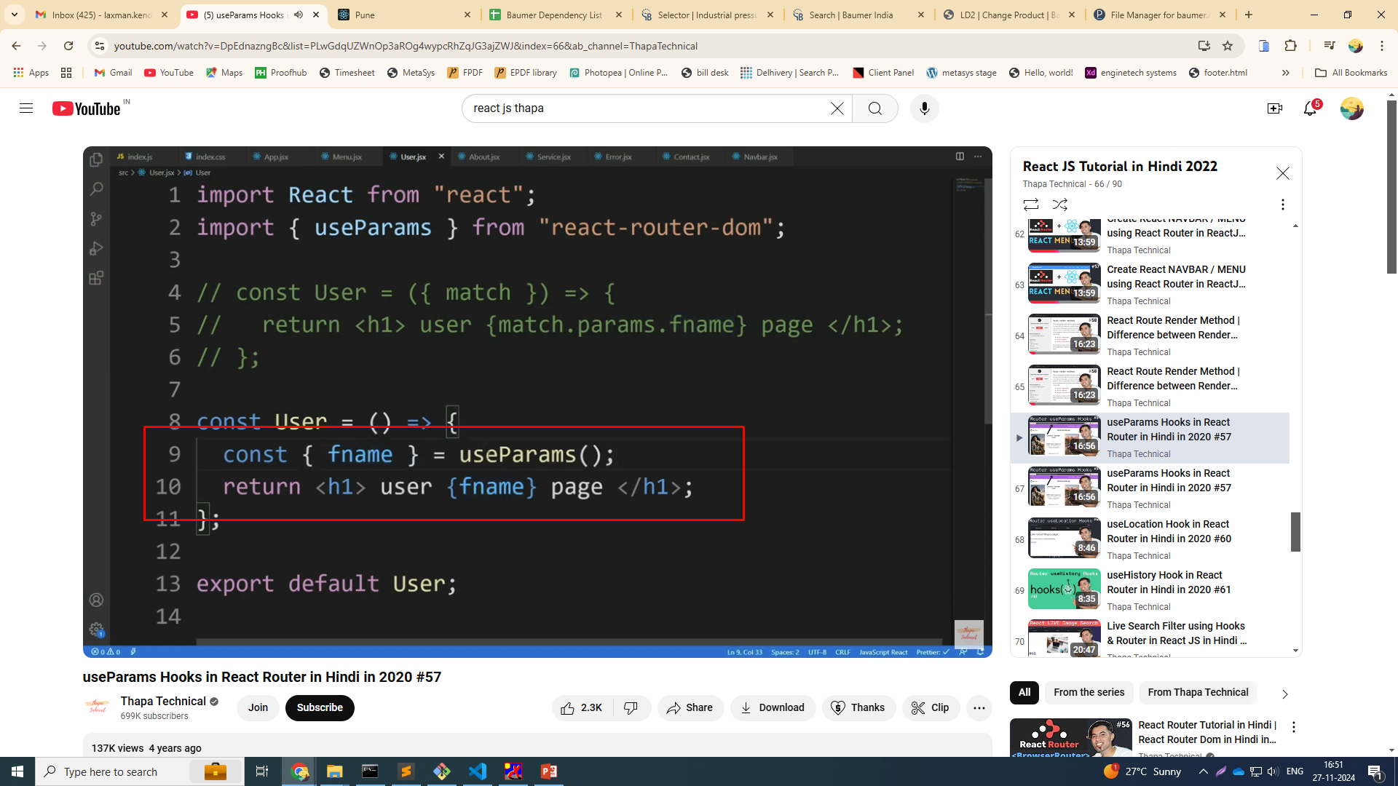
useParams()

Slide 3
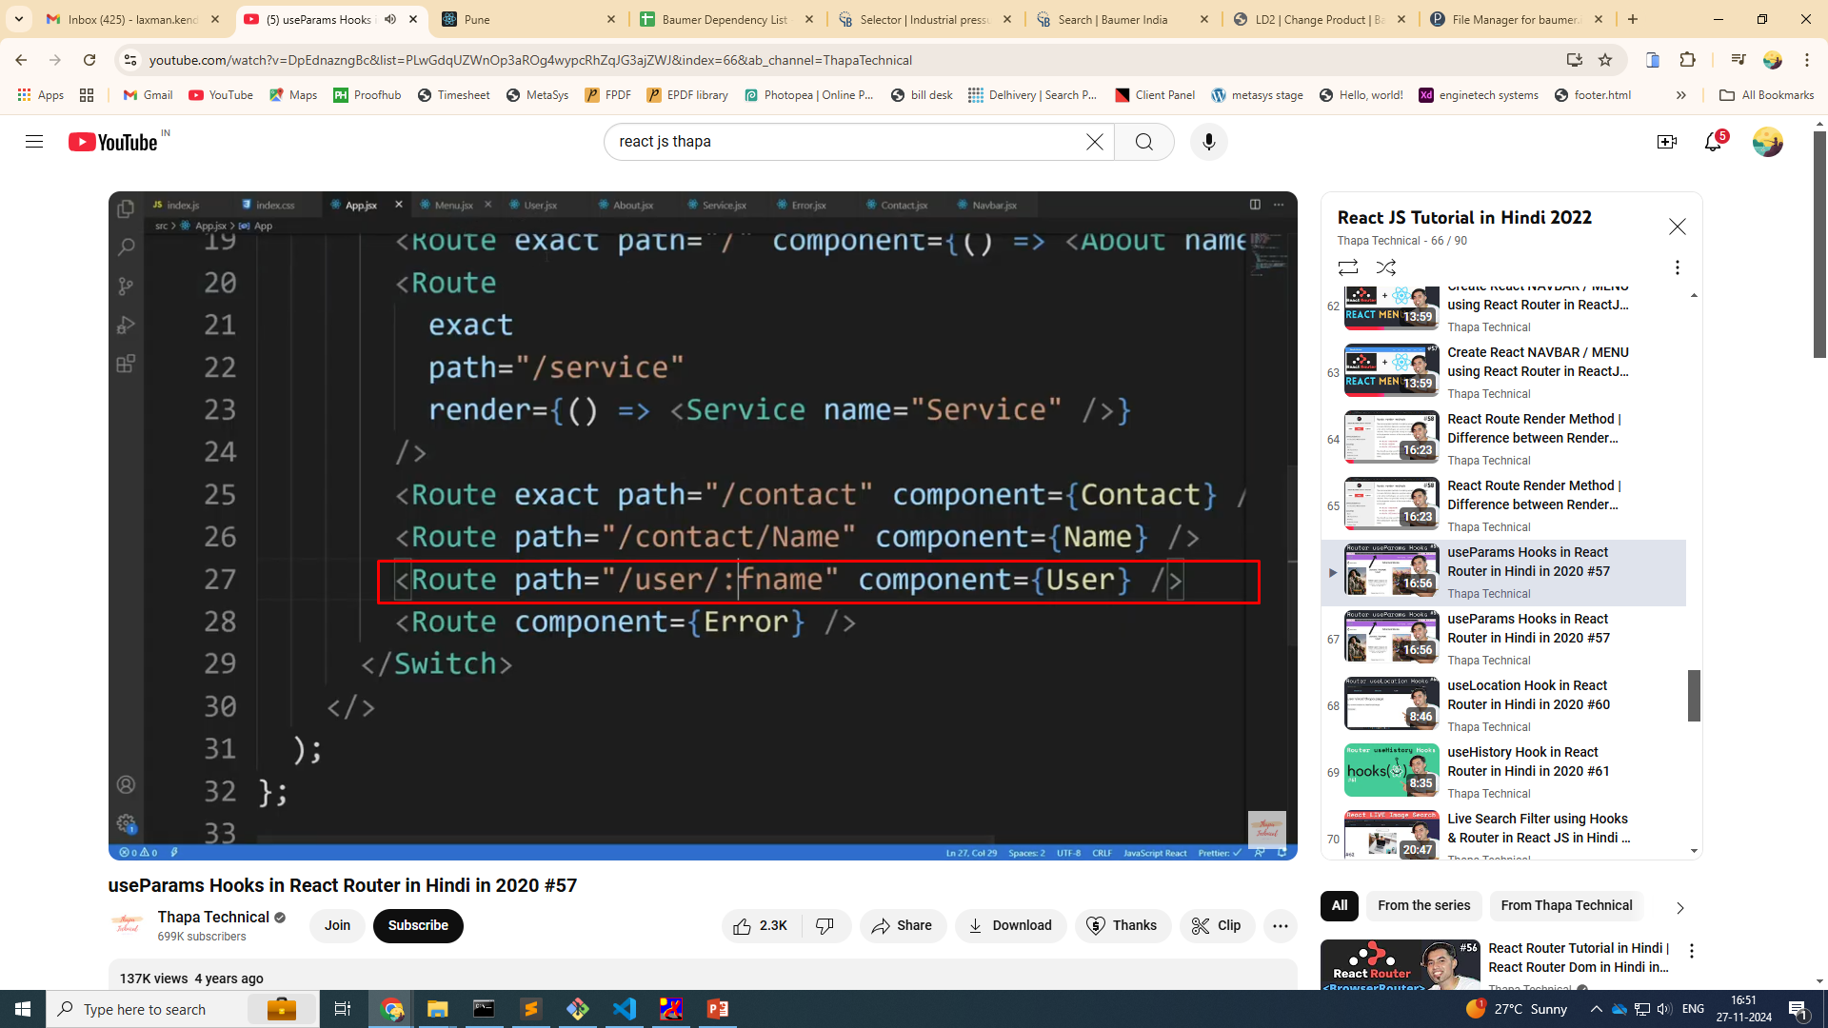

Slide 4
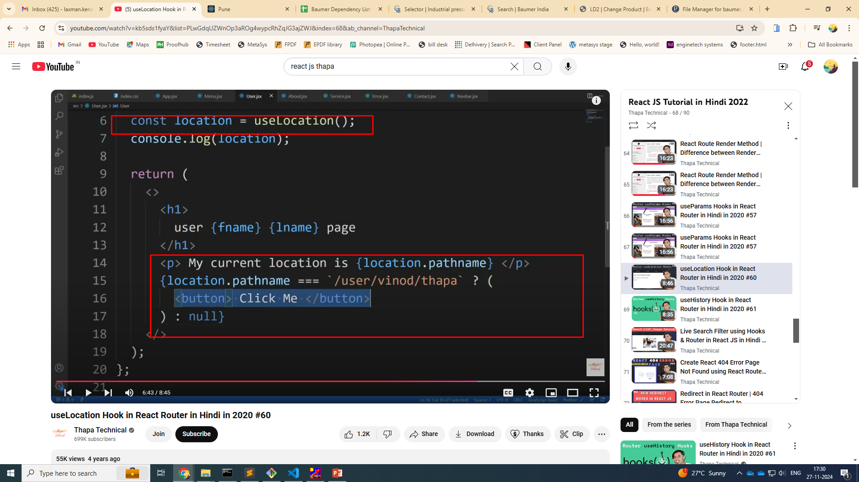
useLocations()

Slide 5
useHistory()

Slide 6
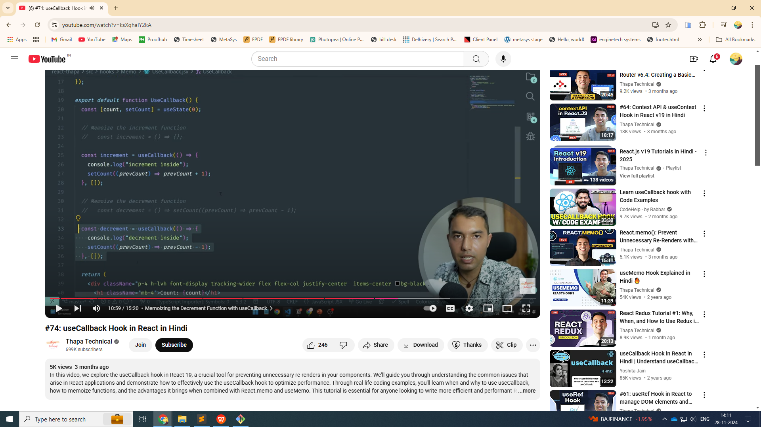
Usecallback()

Slide 7
The useCallback hook in React is used to memoize a function, ensuring that it is only re-created when its dependencies change. This is particularly useful when passing callbacks to child components, as it helps prevent unnecessary re-renders.
Benefits of useCallback
Prevents unnecessary re-renders when callbacks are passed as props to child components.
Helps maintain reference equality, which is crucial when optimizing with React.memo or similar techniques.
When to Use
Use useCallback when you notice performance issues due to frequent re-renders caused by function props.
Don't overuse it; sometimes, React's default behavior of re-creating functions is more efficient than memoization overhead.

Slide 8
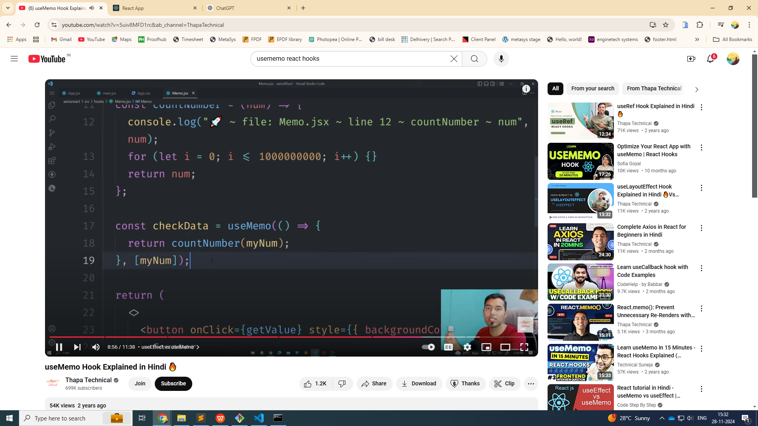
usememo()

Slide 9
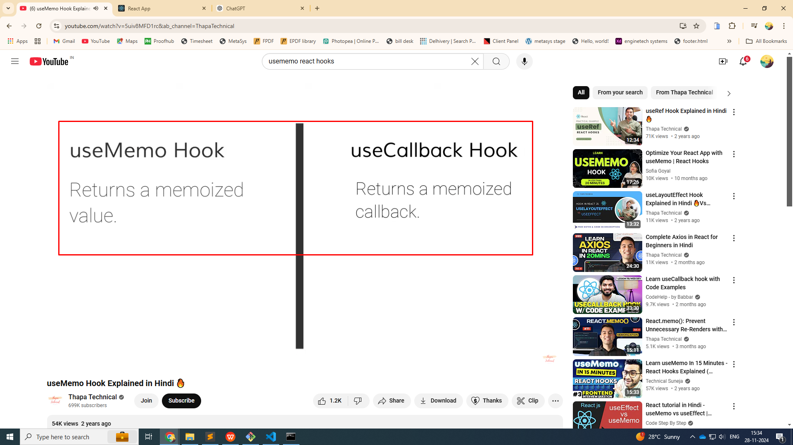

Slide 10
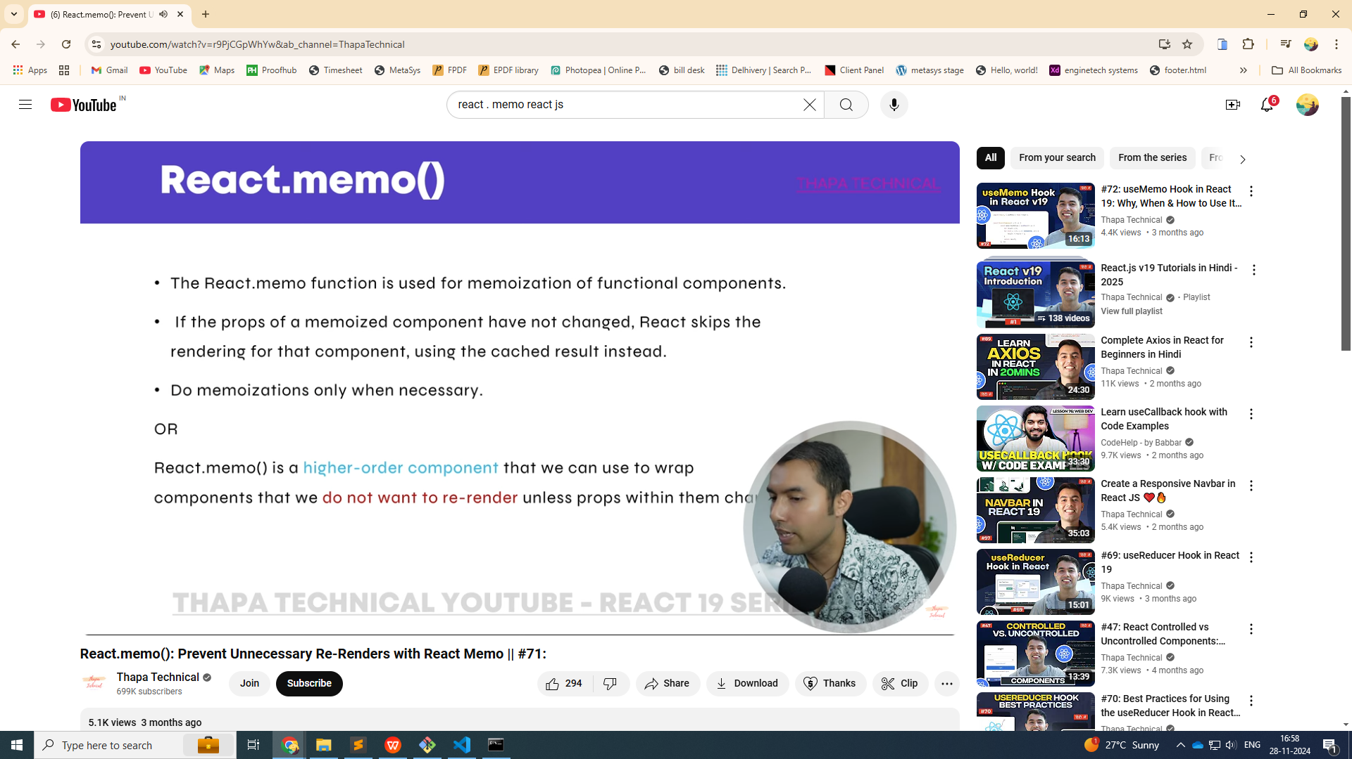
React.memo()

Slide 11
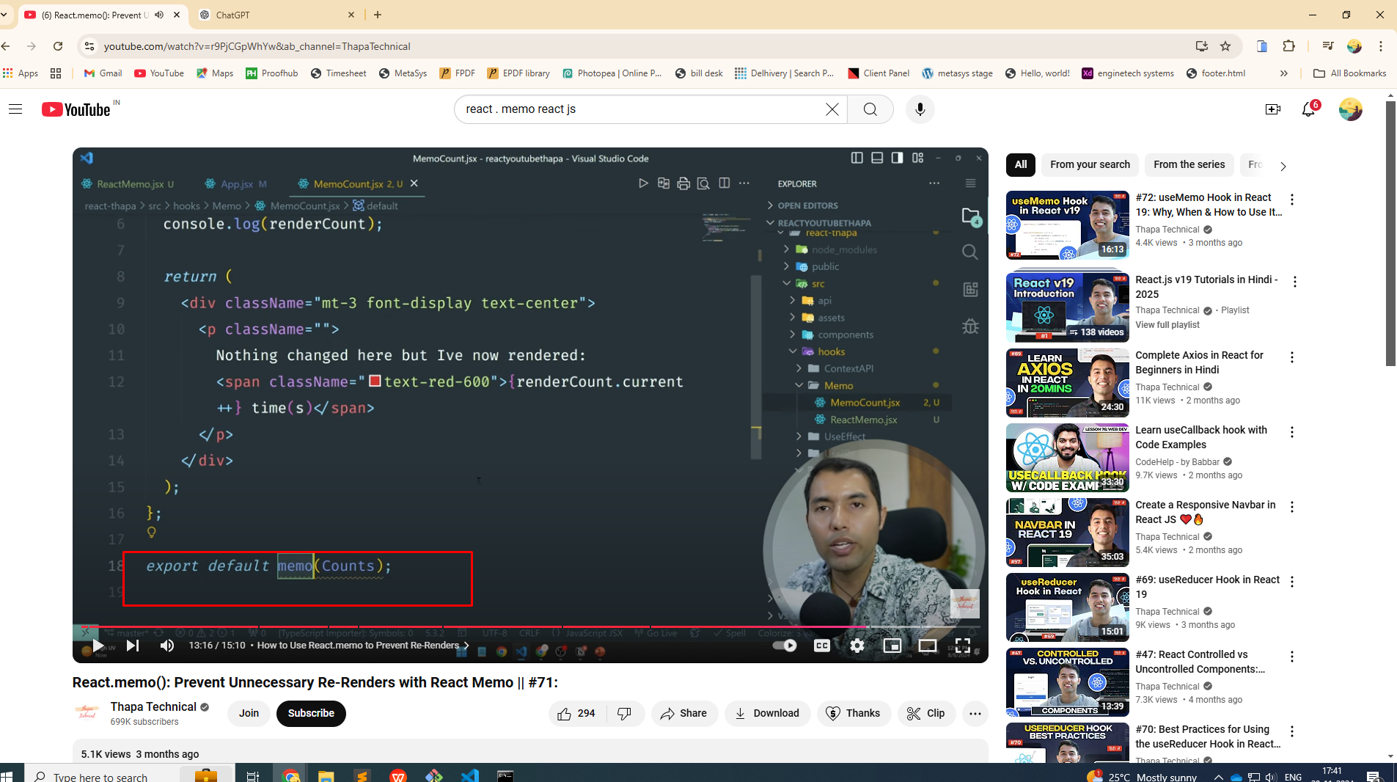

Slide 12
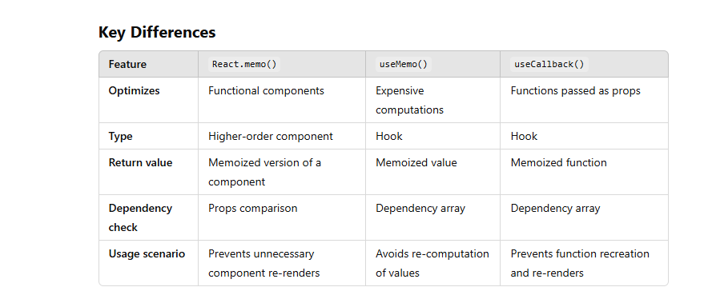

Slide 13
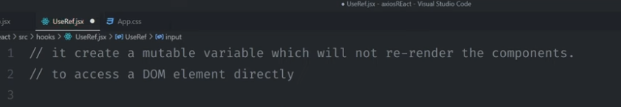
useRef()

Slide 14
